Slide 1
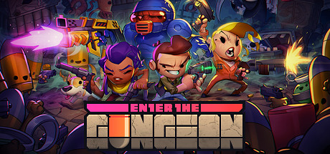
Dungeon Crawler
Daniel and Anthony

Slide 2
Project Overview
Items (ideas: mob drops, keys) (not done)
Difficulty system (not done)
Weapons (melee + ranged weapons possibly) (in progress)
Health System (mostly done)
Maybe powerups if possible (not done)
Top down perspective from character (mostly done)
Gun mechanics - damage, hit detection, ammo count, fire rate (mostly done)

Slide 3
Current State
Random map generation
Character movement
Collisions
Health System
textures
gun mechanics

Slide 4

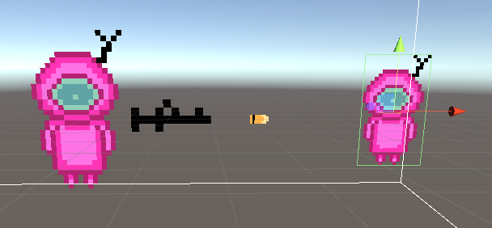
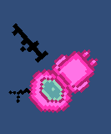
Screenshots
Mouse aim 360 motion
Left-click shooting
-Bullet detection with box collider (right)

Slide 5
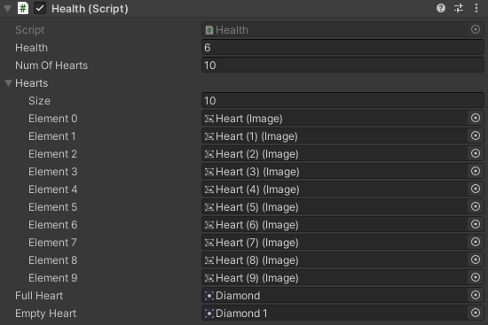
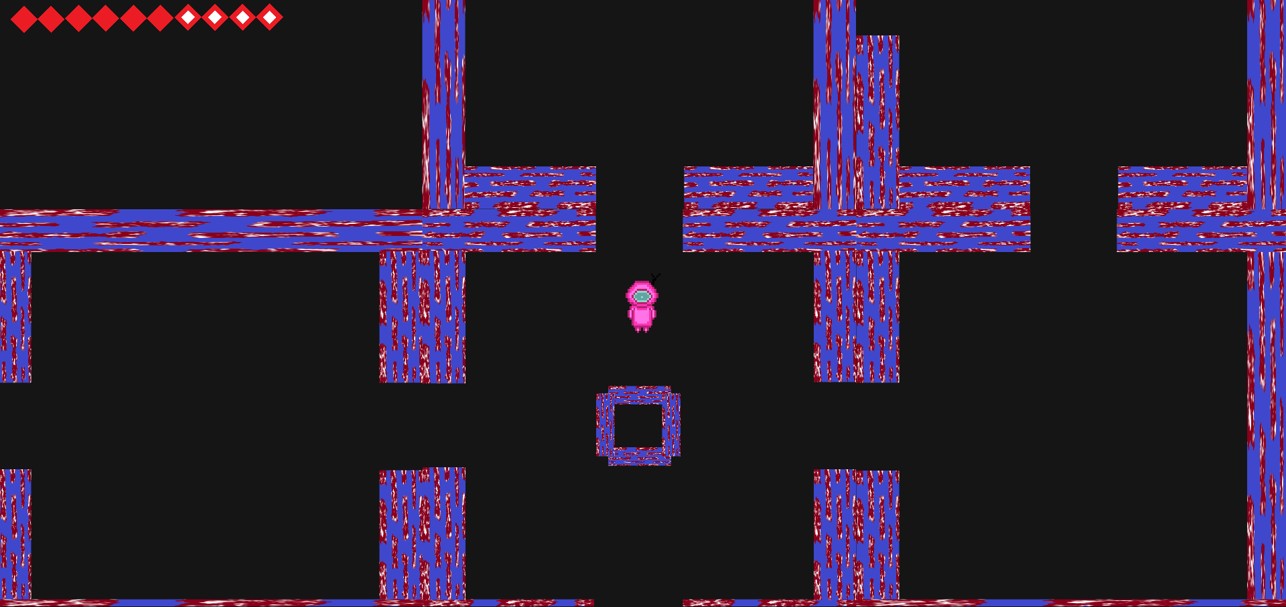
Screenshots (New Updates)
Ff
Map generation, with health bar and character movement

Slide 6
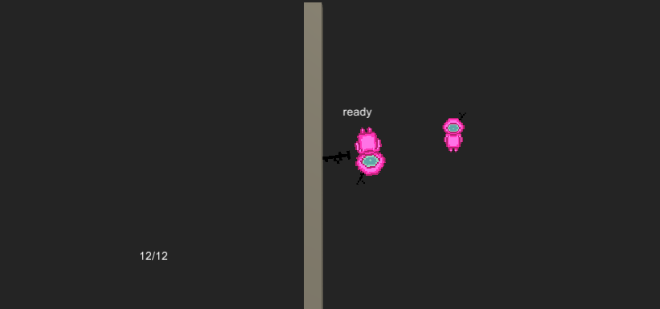
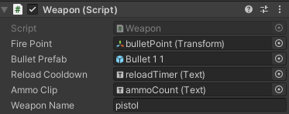
Screenshots (New Updates)
Weapon names can be customizable where they have a predetermined damage, fire rate, bullet speed, ammo count, whether its full auto
Text UI tells you ammo count, fire rate, and reload time

Slide 7
What we plan to do next
Adding enemy AI that can attack the player, a health system (spawn point, door interactions, etc)
Maybe start making pixel sprites (for player)

